Slide 1



AUTOMATION FOR EVERYONE
Ansible technical introduction and overview

Slide 2


Automation happens when one person meets a problem they never want to solve again
Notes:
We’re faced with numerous challenges in IT. You live them every day. Regardless of your role or responsibility.
Effort->time; time->money…
BUT Effort has a human toll.
In the end, we’re just people. People trying to work with other people, and force machines to do the work to be done.
Your reasons for automating are pretty straightforward. You’re tired of doing the same thing over and over again.
Automation makes our jobs and lives easier.
It presents an opportunity to do more.

Slide 3



ACCELERATE
INTEGRATE
COLLABORATE
Notes:
And we know the power of automation--otherwise we wouldn’t be here today.
We’d probably be back in our offices grinding out config files one by one.
What we’re here to talk about today is what we are doing with Ansible to help you take automation further:
By doing more faster…
By bringing technologies together so you can automate them
And by helping you and your teams automate together so you can extend the power of Ansible across your entire organization

Slide 4


WHAT IS ANSIBLE AUTOMATION?
Ansible Automation is the enterprise framework for automating across IT operations.
Ansible Engine runs Ansible Playbooks, the automation language that can perfectly describe an IT application infrastructure.
Ansible Tower allows you scale IT automation, manage complex deployments and speed productivity.
RED HAT ANSIBLE TOWER
Operationalize your automation
CONTROL
DELEGATION
SCALE
RED HAT ANSIBLE ENGINE
Simple command line automation
SIMPLE
POWERFUL
AGENTLESS
FUELED BY AN INNOVATIVE OPEN SOURCE COMMUNITY

Slide 5




WHY ANSIBLE?
POWERFUL
AGENTLESS
SIMPLE
Human readable automation
No special coding skills needed
Tasks executed in order
Usable by every team
Get productive quickly
App deployment
Configuration management
Workflow orchestration
Network automation
Orchestrate the app lifecycle
Agentless architecture
Uses OpenSSH & WinRM
No agents to exploit or update
Get started immediately
More efficient & more secure
Notes:
Cross platform: Linux, Windows, UNIX, Networks, Clouds
Human readable: YAML
Orchestration plays well with others: HP SA, Puppet, Jenkins, RHNSS, etc.

Slide 6

ANSIBLE AUTOMATION WORKS ACROSS TEAMS
BUSINESS
DEV
NETWORK
QA/SECURITY
I.T. OPERATIONS
Notes:
Ansible is the Lingua Franca of the enterprise
It empowers development to production, from IT to the business
----------------------------------------------------------------
Points Tim Yeaton added here in his delivery:
memorialize/institutionalize in the Playbook
Standardize on Ansible
You need a language to help articulate the workflow all they way through live production
Use a language to communicate and facilitate between dev and ops
Becomes fact based or system of record once written in a Playbook

Slide 7
WHAT CAN I DO USING ANSIBLE?
Automate the deployment and management of your entire IT footprint.
Do this...
Orchestration
Configuration Management
Application Deployment
Provisioning
Continuous Delivery
Security and Compliance
On these...
Firewalls
Load Balancers
Applications
Containers
Clouds
Servers
Infrastructure
Storage
Network Devices
And more...

Slide 8
ANSIBLE AUTOMATES TECHNOLOGIES YOU USE Time to automate is measured in minutes
CLOUD
VIRT & CONTAINER
WINDOWS
NETWORK
DEVOPS
MONITORING
AWS
Azure
Digital Ocean
Google
OpenStack
Rackspace
+more
Docker
VMware
RHV
OpenStack
OpenShift
+more
ACLs
Files
Packages
IIS
Regedits
Shares
Services
Configs
Users
Domains
+more
Arista
A10
Cumulus
Bigswitch
Cisco
Cumulus
Dell
F5
Juniper
Palo Alto
OpenSwitch
+more
Jira
GitHub
Vagrant
Jenkins
Bamboo
Atlassian
Subversion
Slack
Hipchat
+more
Dynatrace
Airbrake
BigPanda
Datadog
LogicMonitor
Nagios
New Relic
PagerDuty
Sensu
StackDriver
Zabbix
+more
OPERATING SYSTEMS
RHEL and Linux
UNIX
Windows
+more
STORAGE
NetApp
Red Hat Storage
Infinidat
+more
Notes:
Agentless architecture
Uses OpenSSH and WinRM
No agents to exploit or update
Predictable, reliable and secure
Ansible automates technologies you already use
With the power of a community behind it generating more integrations every day
----------------------------------------------------------------
Points Tim Yeaton added here in his delivery:
Communities of partners building around our language
Tremendous adoption to date - realization in order to scale you have to automate

Slide 9


FINANCIAL SUMMARY:
BY THE NUMBERS:
146%
94%
Reduction in recovery time following a security incident
ROI ON ANSIBLE TOWER
84%
Savings by deploying workloads to generic systems appliances using Ansible Tower
3
<
MONTHS
67%
Reduction in man hours required for customer deliveries
PAYBACK ON ANSIBLE TOWER
SOURCE: "The Total Economic Impact™ Of Red Hat Ansible Tower, a June 2018 commissioned study conducted by Forrester Consulting on behalf of Red Hat."
redhat.com/en/engage/total-economic-impact-ansible-tower-20180710

Slide 10


LANGUAGE OF AUTOMATION

Slide 11

CROSS PLATFORM
HUMAN READABLE
PERFECT DESCRIPTION OF APPLICATION
Agentless support for all major OS variants, physical, virtual, cloud and network devices.
Perfectly describe and document every aspect of your application environment.
Every change can be made by Playbooks, ensuring everyone is on the same page.
VERSION CONTROLLED
DYNAMIC INVENTORIES
ORCHESTRATION PLAYS WELL WITH OTHERS
Playbooks are plain-text. Treat them like code in your existing version control.
Capture all the servers 100% of the time, regardless of infrastructure, location, etc.
Orchestration plays well with others: ServiceNow, Infoblox, AWS, Terraform, Cisco ACI and more
Notes:
Cross platform: Linux, Windows, UNIX, Networks, Clouds
Human readable: YAML
Orchestration plays well with others: HP SA, Puppet, Jenkins, RHNSS, etc.

Slide 12
AUTOMATION FOR EVERYONE
---
- name: install and start apache
hosts: web
become: yes
vars:
http_port: 80
tasks:
- name: httpd package is present
yum:
name: httpd
state: latest
- name: latest index.html file is present
copy:
src: files/index.html
dest: /var/www/html/
- name: httpd is started
service:
name: httpd
state: started
Notes:
Playbook example:
The name fields are human-readable comments. Optional, but useful as comments to the Playbook. These strings also show up in Tower, so it is easy to correlate any failures in a long running Playbook.
Inventory call-out
Variables can be handled in several different ways:
Directly in the playbook
As part of a separate vars file
Via the command line
As output from a previous play
Via Tower
You are not required to use root as the remote user. You can have Ansible connect and run the playbook as any user or even multiple users – as long as that user has the permission to perform the tasks in the playbook. You can even use multiple users and specify different users for different plays or tasks.
Ansible supports sudo, su, powerbroker, and other privilege escalation mechanisms.
The real work. General format:
<<module>>: key=value

Slide 13










PUBLIC / PRIVATE CLOUD
PUBLIC / PRIVATE CLOUD
CMDB
ANSIBLE AUTOMATION ENGINE
USERS
INVENTORY
CLI
HOSTS
MODULES
PLUGINS
NETWORK DEVICES
ANSIBLE PLAYBOOK

Slide 14
PUBLIC / PRIVATE CLOUD
PUBLIC / PRIVATE CLOUD
CMDB
ANSIBLE AUTOMATION ENGINE
PLAYBOOKS ARE WRITTEN IN YAML
Tasks are executed sequentially
Invoke Ansible modules
USERS
INVENTORY
CLI
HOSTS
MODULES
PLUGINS
NETWORK DEVICES
ANSIBLE PLAYBOOK

Slide 15
PUBLIC / PRIVATE CLOUD
PUBLIC / PRIVATE CLOUD
CMDB
MODULES ARE “TOOLS IN THE TOOLKIT”
Python, Powershell, or any language
Extend Ansible simplicity to the entire stack
ANSIBLE AUTOMATION ENGINE
USERS
INVENTORY
CLI
HOSTS
MODULES
PLUGINS
NETWORK DEVICES
ANSIBLE PLAYBOOK
CORE
NETWORK
COMMUNITY

Slide 16
PUBLIC / PRIVATE CLOUD
PUBLIC / PRIVATE CLOUD
CMDB
PLUGINS ARE “GEARS IN THE ENGINE”
Code that plugs into the core engine
Adaptability for various uses & platforms
ANSIBLE AUTOMATION ENGINE
USERS
INVENTORY
CLI
HOSTS
MODULES
PLUGINS
NETWORK DEVICES
ANSIBLE PLAYBOOK
Notes:
Plugins are pieces of code that augment Ansible’s core functionality. Ansible uses a plugin architecture to enable a rich, flexible and expandable feature set.
Ansible ships with a number of handy plugins, and you can easily write your own.

Slide 17
PUBLIC / PRIVATE CLOUD
PUBLIC / PRIVATE CLOUD
CMDB
INVENTORY
[web]
webserver1.example.com
webserver2.example.com
[db]
dbserver1.example.com
[switches]
leaf01.internal.com
leaf02.internal.com
[firewalls]
checkpoint01.internal.com
[lb]
f5-01.internal.com
ANSIBLE AUTOMATION ENGINE
USERS
INVENTORY
CLI
HOSTS
MODULES
PLUGINS
NETWORK DEVICES
ANSIBLE PLAYBOOK

Slide 18
PUBLIC / PRIVATE CLOUD
PUBLIC / PRIVATE CLOUD
CMDB
ANSIBLE AUTOMATION ENGINE
USERS
INVENTORY
CLI
HOSTS
CLOUD
Red Hat Openstack, Red Hat Satellite, VMware, AWS EC2, Rackspace, Google Compute Engine, Azure
MODULES
PLUGINS
NETWORK DEVICES
ANSIBLE PLAYBOOK

Slide 19
PUBLIC / PRIVATE CLOUD
PUBLIC / PRIVATE CLOUD
CMDB
ANSIBLE AUTOMATION ENGINE
CMDB
ServiceNow, Cobbler, BMC, Custom cmdb
USERS
INVENTORY
CLI
HOSTS
MODULES
PLUGINS
NETWORK DEVICES
ANSIBLE PLAYBOOK

Slide 20
PUBLIC / PRIVATE CLOUD
PUBLIC / PRIVATE CLOUD
CMDB
ANSIBLE AUTOMATION ENGINE
USERS
INVENTORY
CLI
HOSTS
MODULES
PLUGINS
AUTOMATE EVERYTHING
Red Hat Enterprise Linux, Ubuntu, Debian,
Cisco routers, Arista switches, Juniper routers,
Windows hosts, Checkpoint firewalls and more
NETWORK DEVICES
ANSIBLE PLAYBOOK

Slide 21
GITHUB
github.com/ansible/ansible-examples
LAMP + HAPROXY + NAGIOS github.com/ansible/ansible-examples/tree/master/lamp_haproxy
WINDOWS github.com/ansible/ansible-examples/tree/master/windows
SECURITY COMPLIANCE github.com/ansible/ansible-lockdown
NETWORK AUTOMATION
ansible.com/linklight
github.com/network-automation
PLAYBOOK EXAMPLES:

Slide 22


AUTOMATION ACROSS
THE ENTERPRISE
Notes:
Control, Knowledge, Delegation
RBAC
Push button deployment (Delegation)
Centralized logging (auditing, compliance)
RESTful API
Role-based access control keeps environments secure, and teams efficient
Non-privileged users can safely deploy entire applications with push-button deployment access
All Ansible automations are centrally logged, ensuring complete auditability and compliance
Centralize and control your IT infrastructure with a visual dashboard, role-based access control, job scheduling, integrated notifications and graphical inventory management.

Slide 23
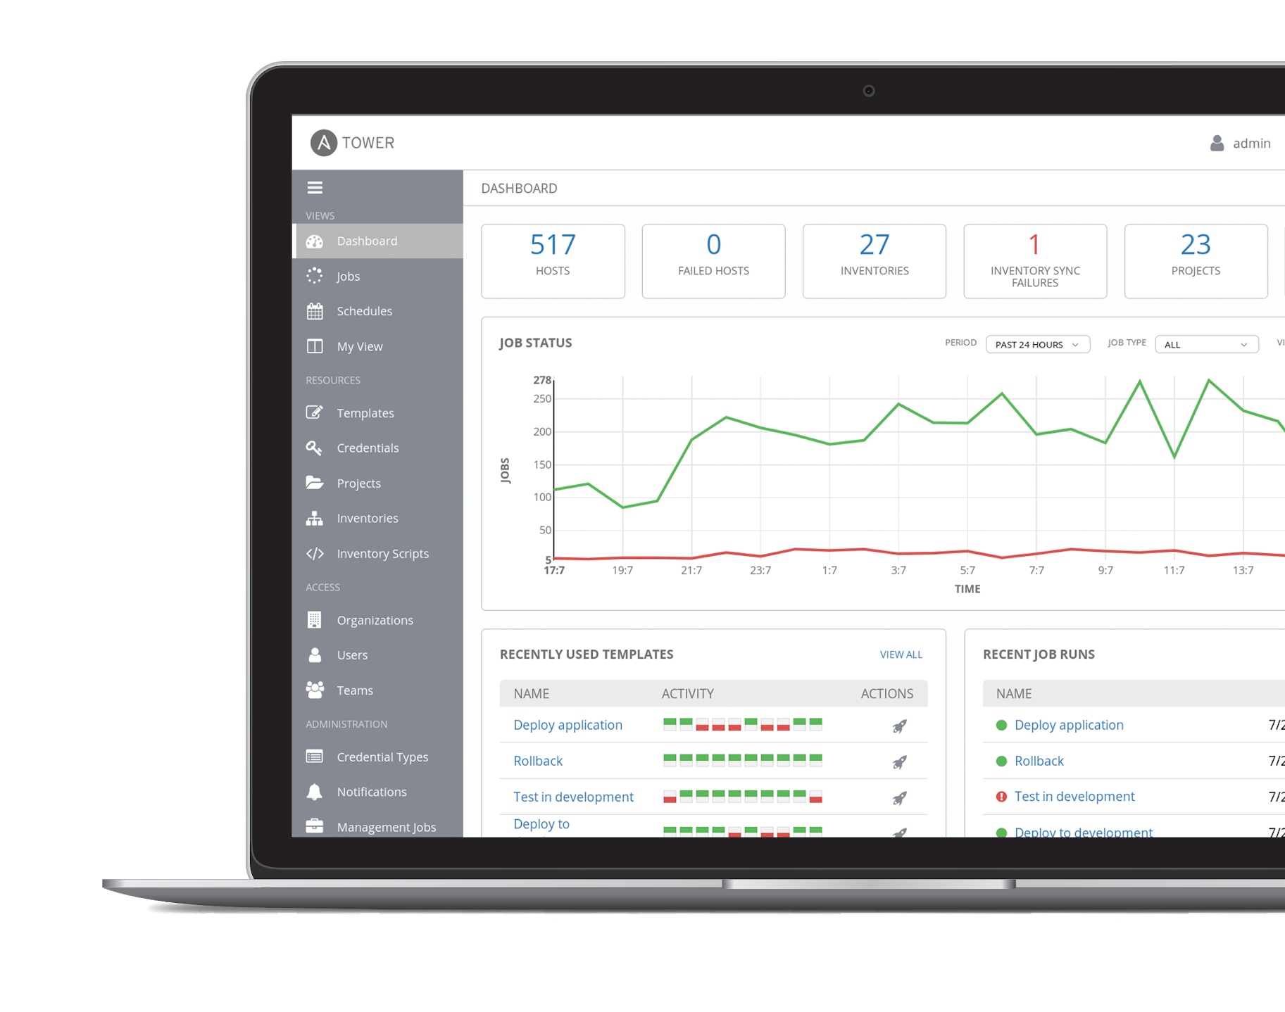
WHAT IS ANSIBLE TOWER?
Ansible Tower is a UI and RESTful API allowing you to scale IT automation, manage complex deployments and speed productivity.
• Role-based access control
• Deploy entire applications with push-button deployment access
• All automations are centrally logged
• Powerful workflows match your IT processes
Notes:
Control, Knowledge, Delegation
When more than one person is running the same playbook in the organization, Ansible Tower is valuable.
RBAC
Push button deployment (Delegation)
Centralized logging (auditing, compliance)
RESTful API
Role-based access control keeps environments secure, and teams efficient
Non-privileged users can safely deploy entire applications with push-button deployment access
All Ansible automations are centrally logged, ensuring complete auditability and compliance
Centralize and control your IT infrastructure with a visual dashboard, role-based access control, job scheduling, integrated notifications and graphical inventory management.

Slide 24
RBAC
PUSH BUTTON
RESTful API
Allow restricting playbook access to authorized users. One team can use playbooks in check mode (read-only) while others have full administrative abilities.
With an API first mentality every feature and function of Tower can be API driven. Allow seamless integration with other tools like ServiceNow and Infoblox.
An intuitive user interface experience makes it easy for novice users to execute playbooks you allow them access to.
WORKFLOWS
ENTERPRISE INTEGRATIONS
CENTRALIZED LOGGING
Ansible Tower’s multi-playbook workflows chain any number of playbooks, regardless of whether they use different inventories, run as different users, run at once or utilize different credentials.
Integrate with enterprise authentication like TACACS+, RADIUS, Azure AD. Setup token authentication with OAuth 2. Setup notifications with PagerDuty, Slack and Twilio.
All automation activity is securely logged. Who ran it, how they customized it, what it did, where it happened - all securely stored and viewable later, or exported through Ansible Tower’s API.
Notes:
WORKFLOWS
Ansible Tower’s multi-playbook workflows chain any number of playbooks, regardless of whether they use different inventories, run as different users, run at once or utilize different credentials.

Slide 25







….
ANSIBLE CLI & CI SYSTEMS
ADMINS
ANSIBLE PLAYBOOKS
ANSIBLE TOWER
ROLE-BASED ACCESS CONTROL
KNOWLEDGE & VISIBILITY
SCHEDULED & CENTRALIZED JOBS
SIMPLE USER INTERFACE
TOWER API
USERS
ANSIBLE
ENGINE
OPEN SOURCE MODULE LIBRARY
PLUGINS
PYTHON CODEBASE
TRANSPORT SSH, WINRM, ETC.
AUTOMATE YOUR ENTERPRISE
INFRASTRUCTURE
LINUX, WINDOWS,
UNIX …
NETWORKS
ARISTA, CISCO, JUNIPER …
CONTAINERS
DOCKER,
LXC …
CLOUD
AWS, GOOGLE CLOUD, AZURE …
SERVICES
DATABASES,
LOGGING, SOURCE CONTROL MANAGEMENT…
USE CASES
PROVISIONING
CONFIGURATION
MANAGEMENT
APP DEPLOYMENT
CONTINUOUS DELIVERY
SECURITY & COMPLIANCE
ORCHESTRATION
Notes:
Platform overview

Slide 26

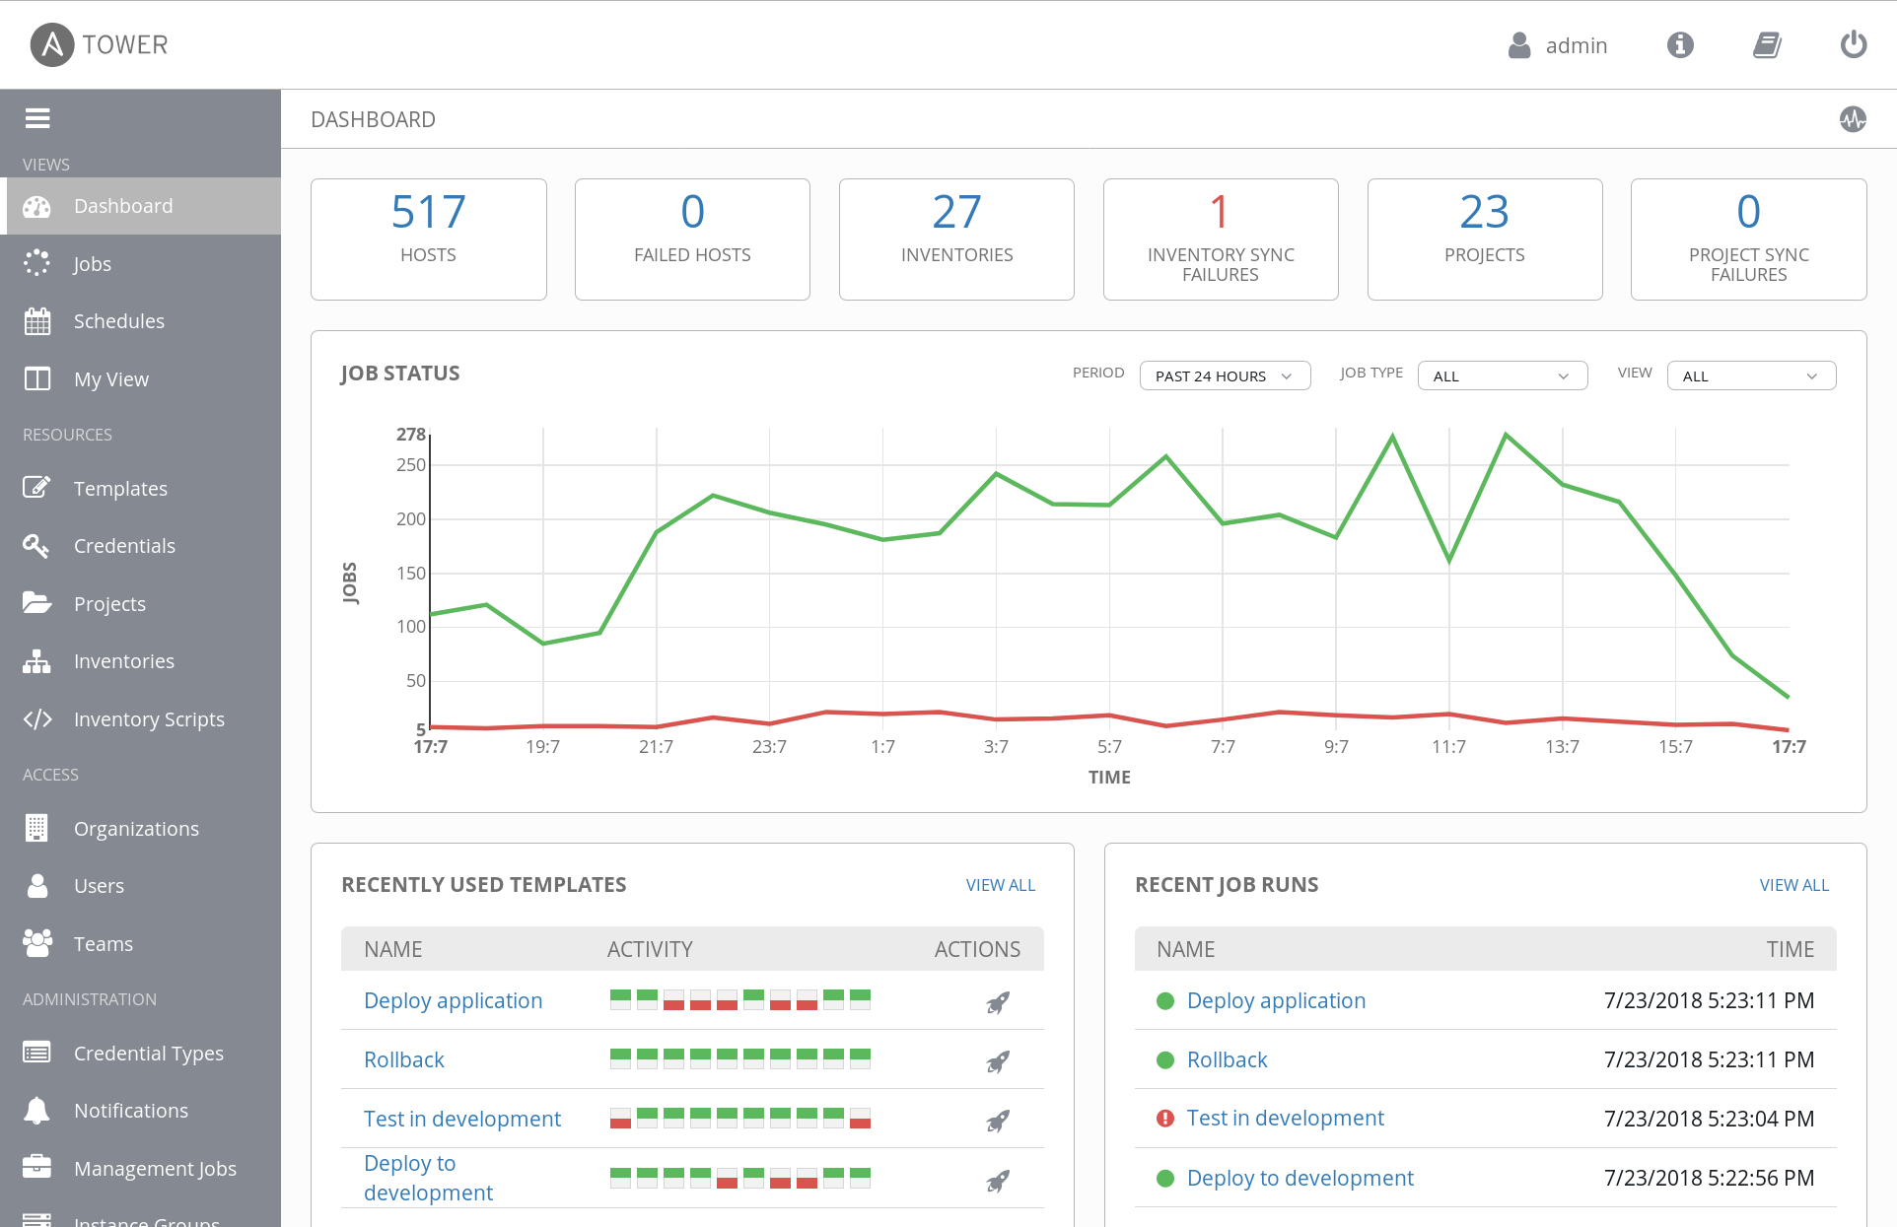
FEATURE OVERVIEW:
CONTROL

Slide 27
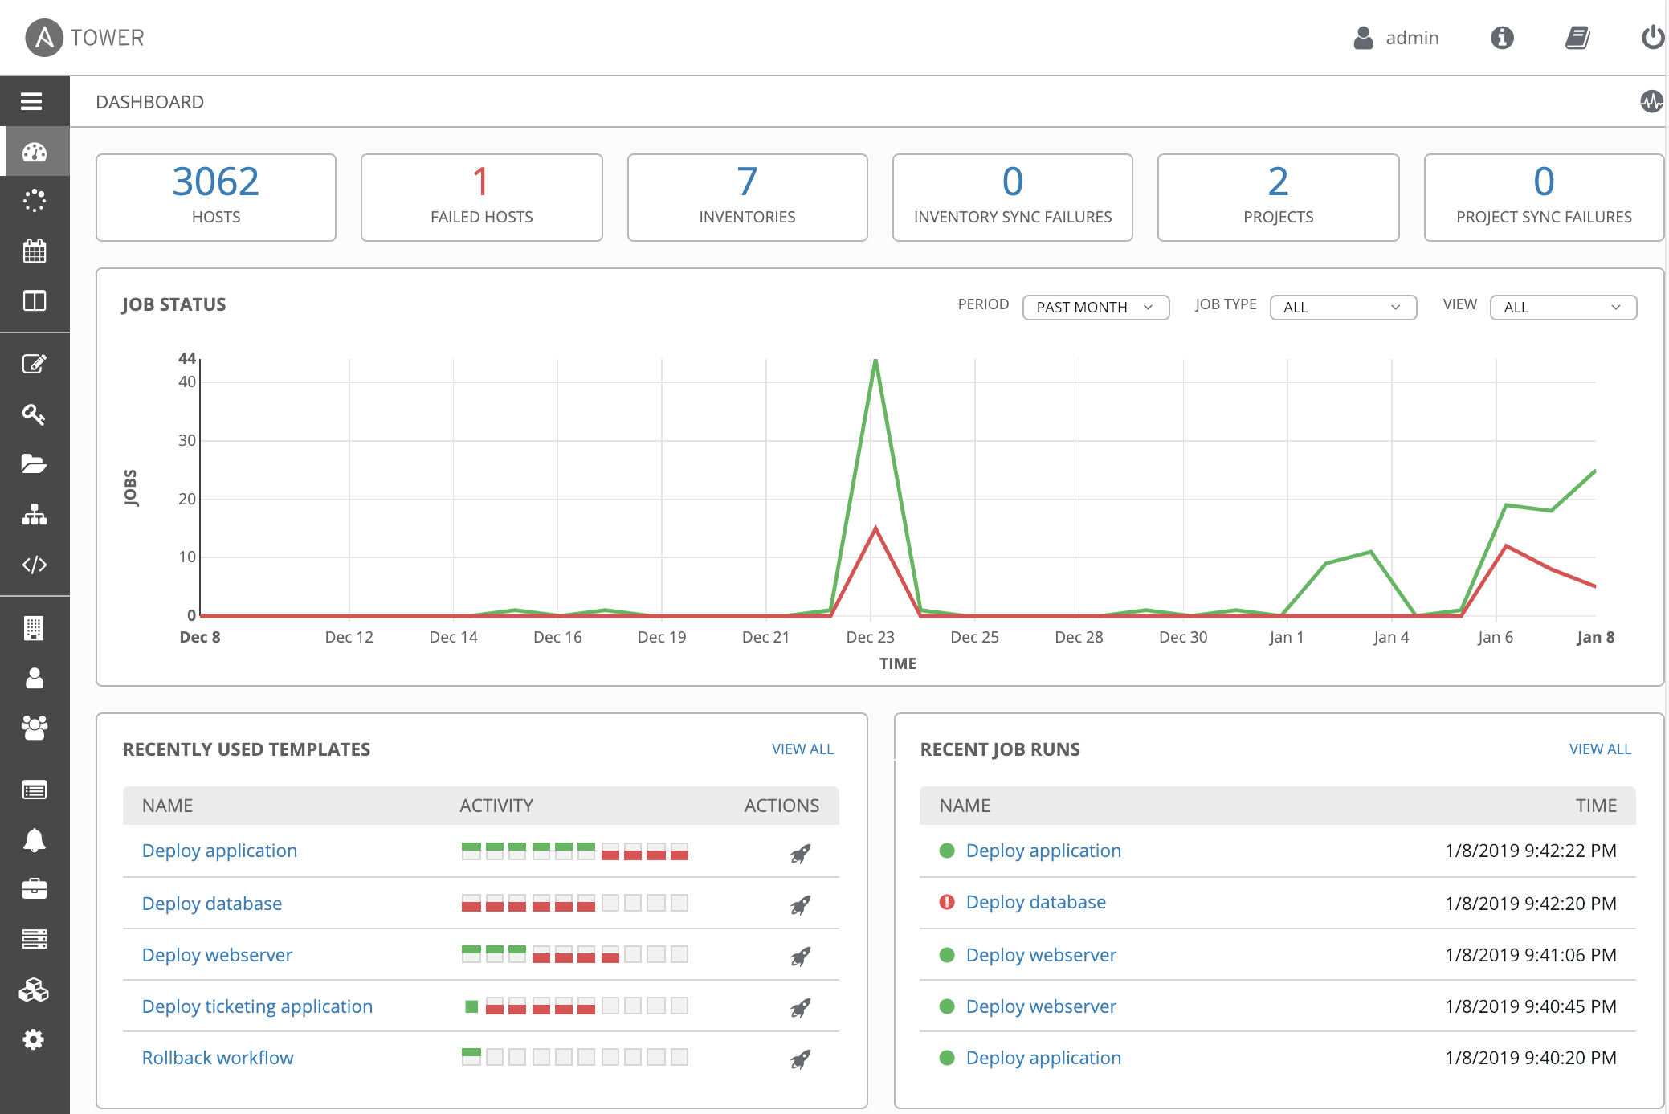
ANSIBLE TOWER FEATURES: YOUR ANSIBLE DASHBOARD
Notes:
Heads-up NOC-style automation dashboard displays everything going on in your Ansible environment.
As soon as you log in, you'll see your host and inventory status, all the recent job activity and a snapshot of recent job runs.

Slide 28
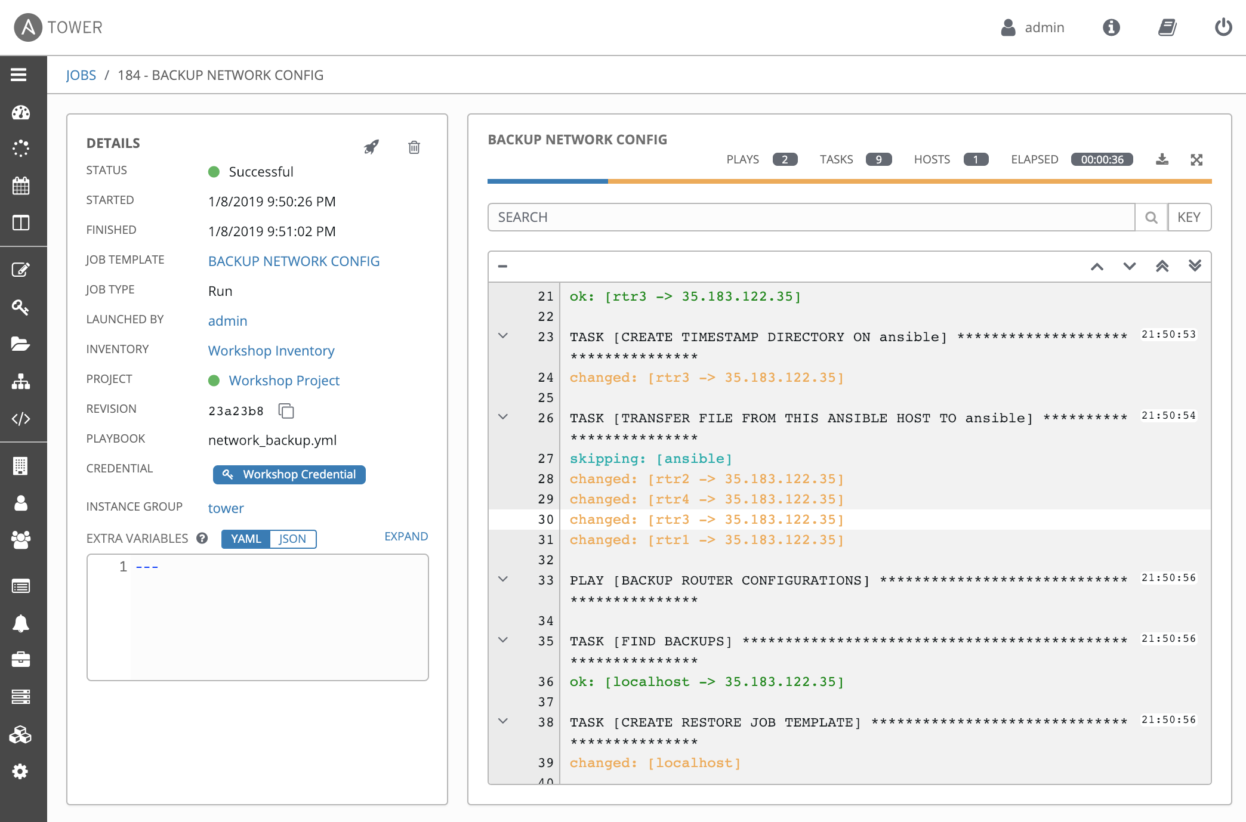
ANSIBLE TOWER FEATURES: JOB STATUS UPDATE
Notes:
Within Ansible Tower, playbook runs stream by in real time. As Ansible automates across your infrastructure, you’ll see plays and tasks complete, broken down by each machine, and each success or failure, complete with output. Know what Ansible Tower is up to at any time.

Slide 29
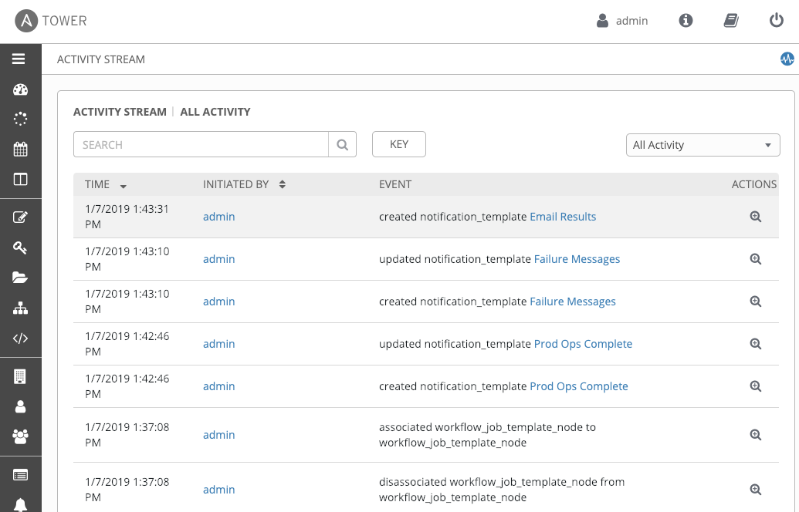
ANSIBLE TOWER FEATURES: ACTIVITY STREAM
Notes:
All automation activity is securely logged. Who ran it, how they customized it, what it did, where it happened - all securely stored and viewable later, or exported through Ansible Tower’s API.
Activity streams extend this by showing a complete audit trail of all changes made to Ansible Tower itself - job creation, inventory changes, credential storage, all securely tracked.

Slide 30
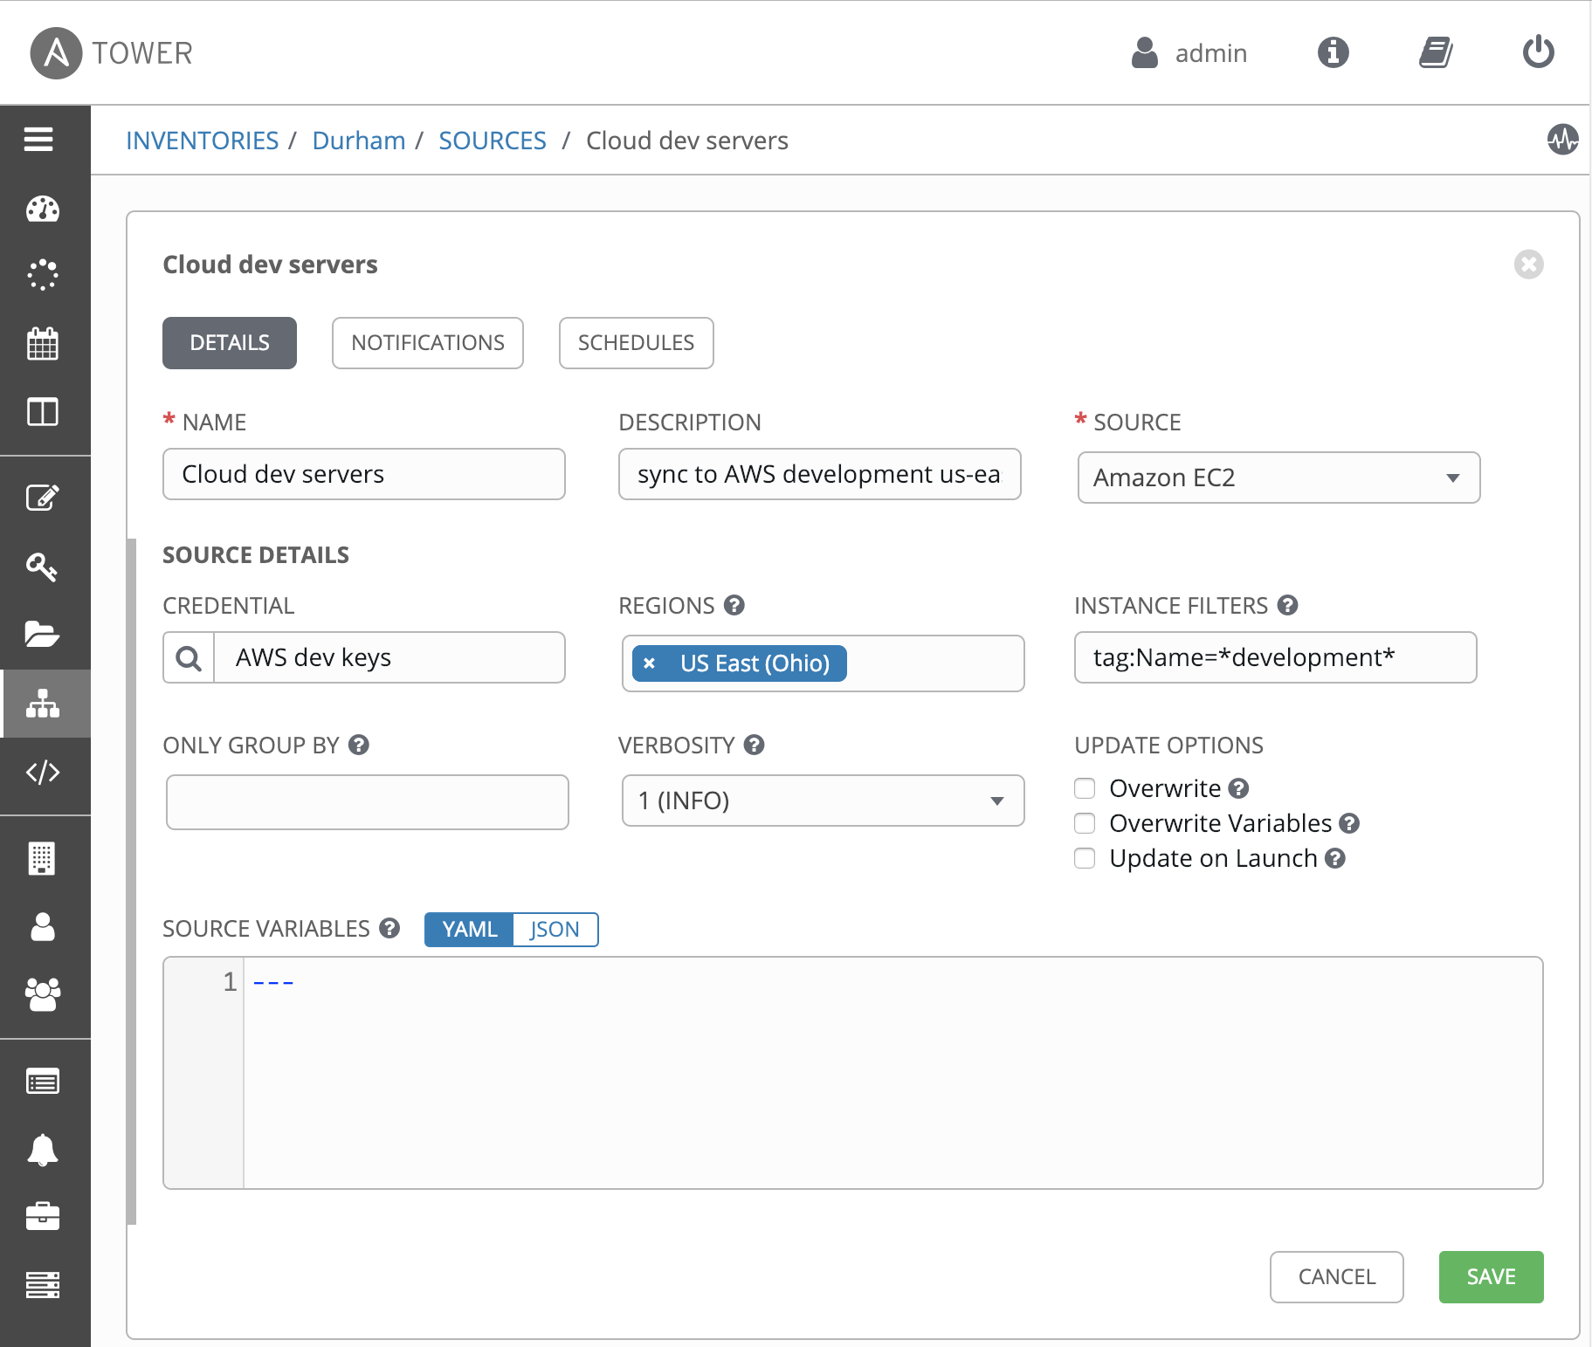
ANSIBLE TOWER FEATURES: MANAGE AND TRACK YOUR INVENTORY
Notes:
Tower’s inventory syncing and provisioning callbacks allow nodes to request configuration on demand, enabling autoscaling.
Smart Inventories allow you to organize and automate hosts across all your providers based on a powerful host fact query engine.
See alerts from Red Hat Insights directly from Tower, and use Insights-provided Playbook Remediation to fix issues in your infrastructure.

Slide 31
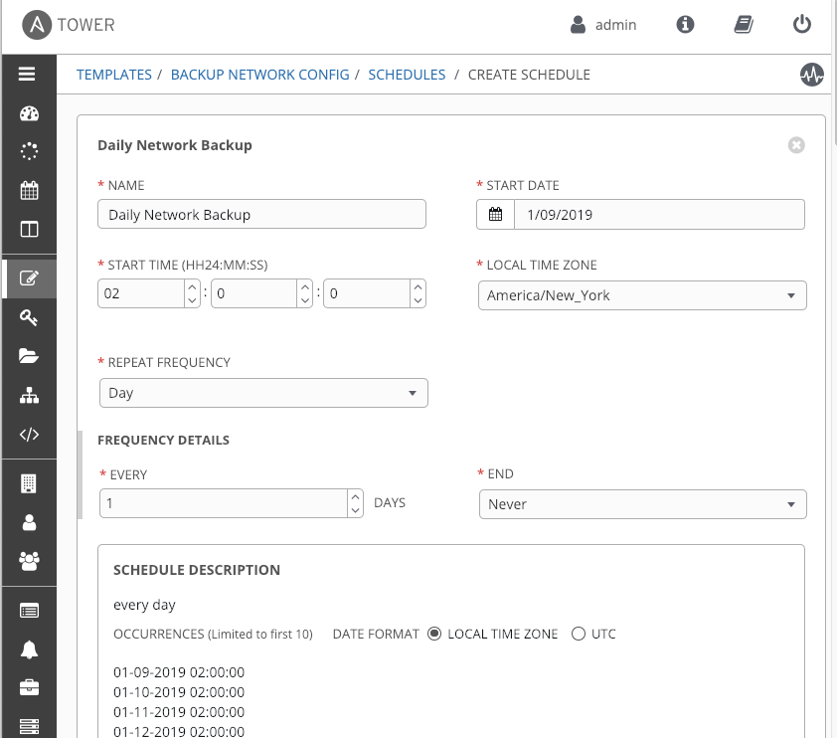
ANSIBLE TOWER FEATURES: SCHEDULE JOBS
Notes:
Enables playbook runs, cloud inventory updates, and source control updates can be scheduled inside Ansible Tower - run now, run later, or run forever.
Set up occasional tasks like nightly backups, periodic configuration remediation for compliance, or a full continuous delivery pipeline with just a few clicks.

Slide 32
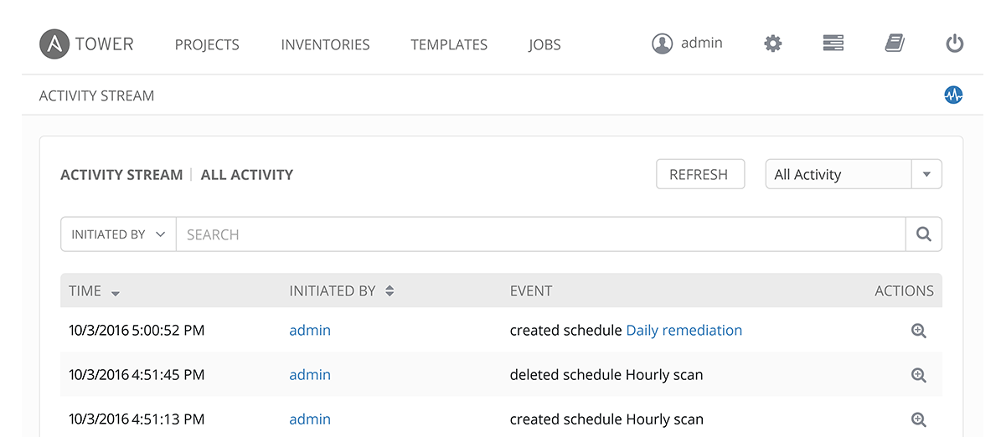
ANSIBLE TOWER FEATURES: EXTERNAL LOGGING
Notes:
Connect Ansible Tower to your external logging and analytics provider to perform analysis of automation and event correlation across your entire environment.

Slide 33
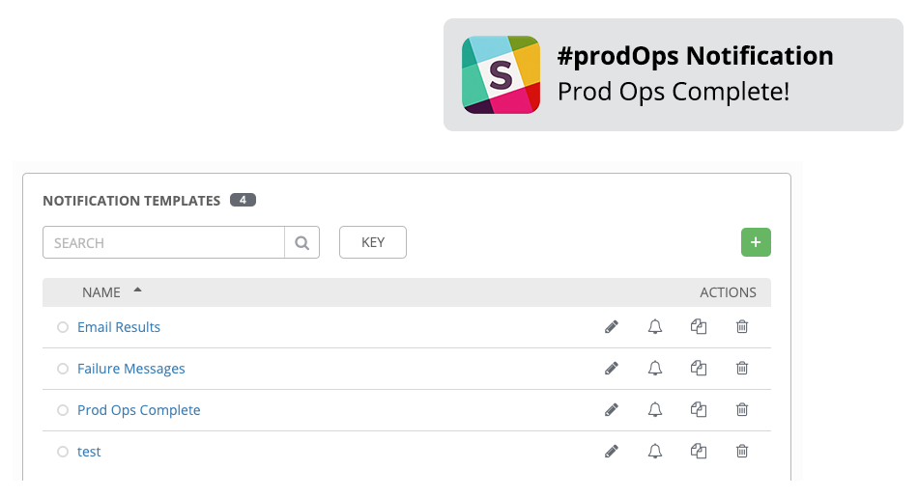
ANSIBLE TOWER FEATURES: INTEGRATED NOTIFICATIONS
Notes:
Notify a person or team when your job succeeds, or escalate when jobs fail. Send notifications across your entire organization at once, or customize on a per-job basis.
Connect your notifications to Slack, Hipchat, PagerDuty, SMS, email, and more - or post notifications to a custom webhook to trigger other tools in your infrastructure.

Slide 34
FEATURE OVERVIEW:
DELEGATION

Slide 35
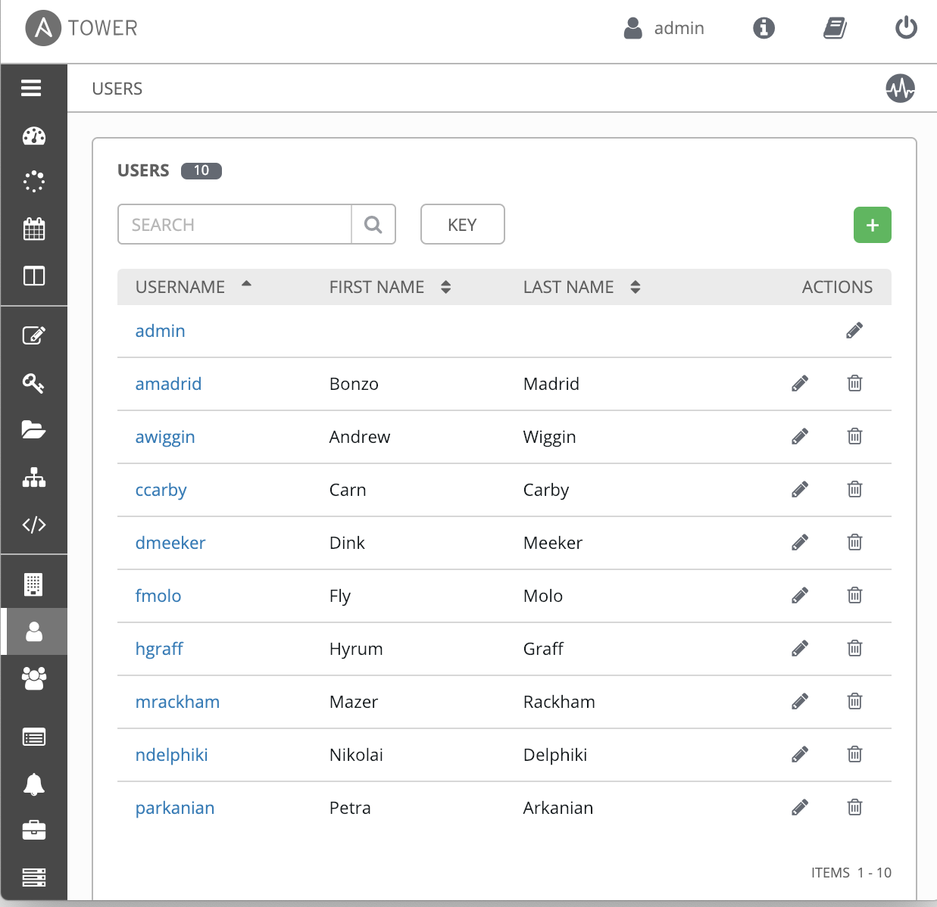
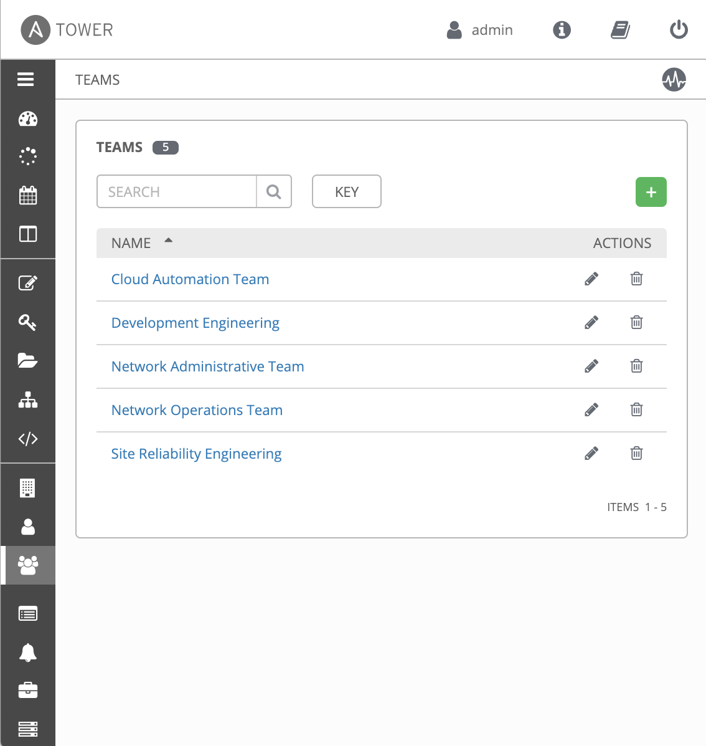
ANSIBLE TOWER FEATURES: ROLE BASED ACCESS CONTROL
USERS
TEAMS
Notes:
Creates the necessary separation and isolation of users and resources. Users can safely use Ansible Tower to work only on the systems in the environments to which they have access
Connect to your corporate Active Directory, LDAP, or SAML identity provider
Delegate to users and teams automatically pulled from your corporate directory
Features:
Create authentication tokens to connect external tools and services such as GitHub
Each organization can have their own custom automation environment

Slide 36
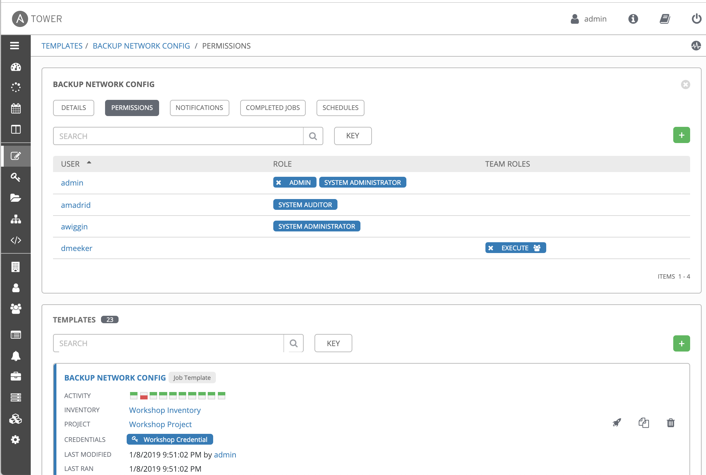
ANSIBLE TOWER FEATURES: ROLE BASED ACCESS CONTROL

Slide 37
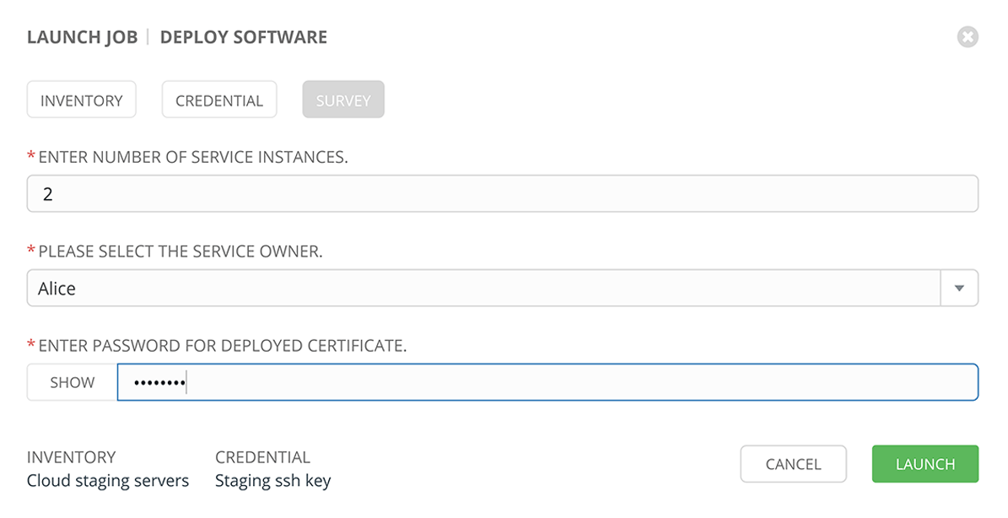
ANSIBLE TOWER FEATURES: SELF-SERVICE I.T.
Notes:
Ansible Tower lets you launch playbooks and workflows with just a single click. It can prompt you for variables, let you choose from available secure credentials and monitor the resulting deployments.

Slide 38
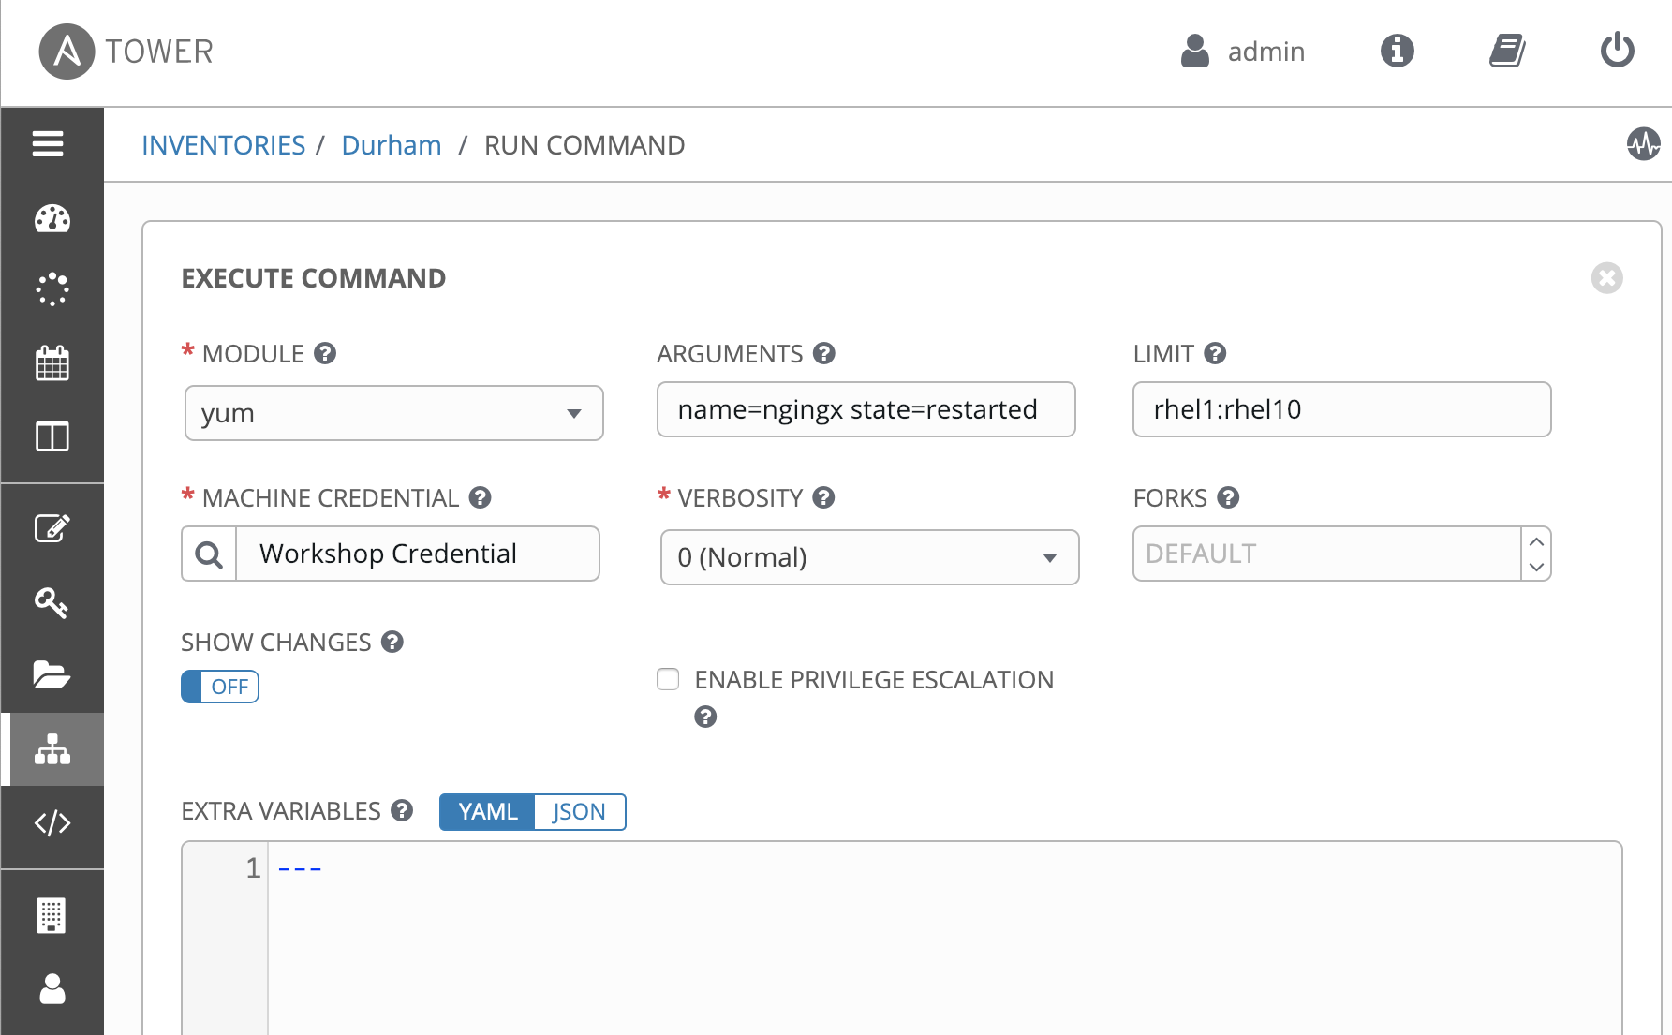
ANSIBLE TOWER FEATURES: REMOTE COMMAND EXECUTION
Notes:
Run simple tasks on any host with Ansible Tower's remote command execution.
Add users or groups, reset passwords, restart a malfunctioning service or patch a critical security issue, quickly.

Slide 39
FEATURE OVERVIEW:
SCALE

Slide 40
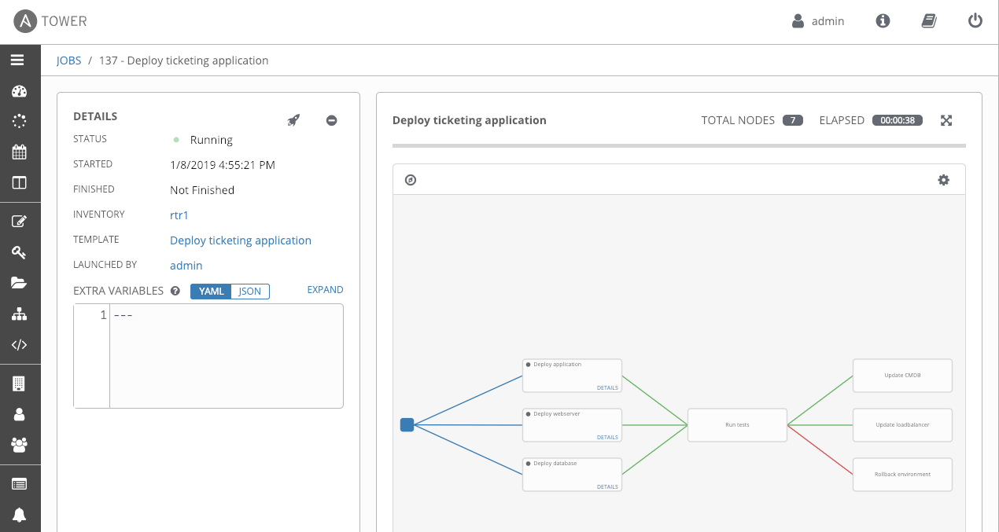
ANSIBLE TOWER FEATURES: CREATE AUTOMATION WORKFLOWS
Notes:
Ansible Tower workflows allow you to chain together different automation tasks to create workflows.
Model your processes and deployments natively in Ansible Tower, including recovery from failures, chained workflows, nested workflows, convergence and more.

Slide 41
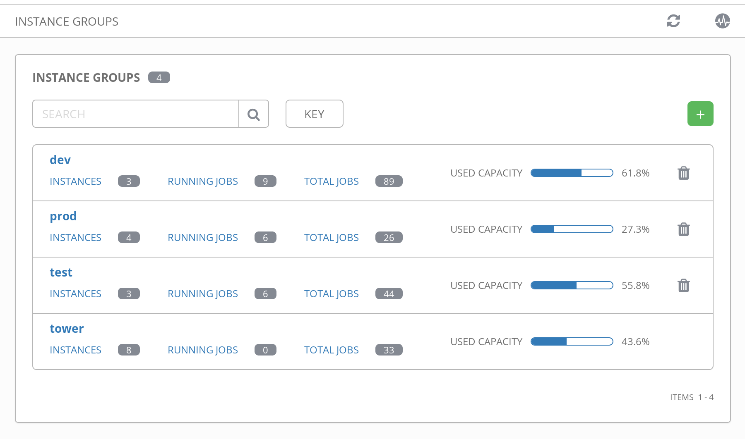
ANSIBLE TOWER FEATURES: SCALE OUT CLUSTERING
Notes:
Connect multiple Tower nodes into a Tower cluster to add redundancy and capacity to your automation platform.
Add reserved capacity, capacity by organization, deploy remote execution nodes for additional local capacity.
Push-button Ansible Tower deployment and dynamic scaling at runtime for Red Hat OpenShift Container Platform users.

Slide 42
USE CASE: LINUX AUTOMATION

Slide 43
LINUX AUTOMATION
150+
Linux Modules
AUTOMATE EVERYTHING LINUX Red Hat Enterprise Linux, BSD, Debian, Ubuntu and many more!
ONLY REQUIREMENTS:
Python 2 (2.6 or later) or Python 3 (3.5 or later)
ansible.com/get-started
Notes:
60+ System Modules - https://docs.ansible.com/ansible/latest/modules/list_of_system_modules.html
50+ Packaging Modules - https://docs.ansible.com/ansible/latest/modules/list_of_packaging_modules.html
20+ File Modules - https://docs.ansible.com/ansible/latest/modules/list_of_files_modules.html
7+ Command Modules - https://docs.ansible.com/ansible/latest/modules/list_of_commands_modules.html
10+ Clustering Modules https://docs.ansible.com/ansible/latest/modules/list_of_clustering_modules.html
Automate every task and process on Linux
Managed nodes requirements: https://docs.ansible.com/ansible/latest/installation_guide/intro_installation.html#managed-node-requirements

Slide 44
AUTOMATION FOR EVERYONE: SYSTEM ADMINISTRATORS
---
- name: upgrade rhel packages
hosts: rhel
tasks:
- name: upgrade all packages
yum:
name: '*'
state: latest

Slide 45
AUTOMATION FOR EVERYONE: SYSTEM ADMINISTRATORS
---
- name: reboot rhel hosts
hosts: rhel
tasks:
- name: reboot the machine
reboot:

Slide 46
AUTOMATION FOR EVERYONE: SYSTEM ADMINISTRATORS
---
- name: check services on rhel hosts
hosts: rhel
become: yes
tasks:
- name: ensure nginx is started
service:
name: nginx
state: started

Slide 47
USE CASE: NETWORK AUTOMATION

Slide 48
ANSIBLE NETWORK AUTOMATION
50
Network Platforms
700+
Network Modules
12*
Galaxy Network Roles
ansible.com/for/networks
galaxy.ansible.com/ansible-network
*Roles developed and maintained by Ansible Network Engineering
Notes:
Ansible Network modules comprise 1/3 of all modules that ship with Ansible Engine. Hoping to be able to search against Galaxy some day for all Ansible Network community Roles.

Slide 49
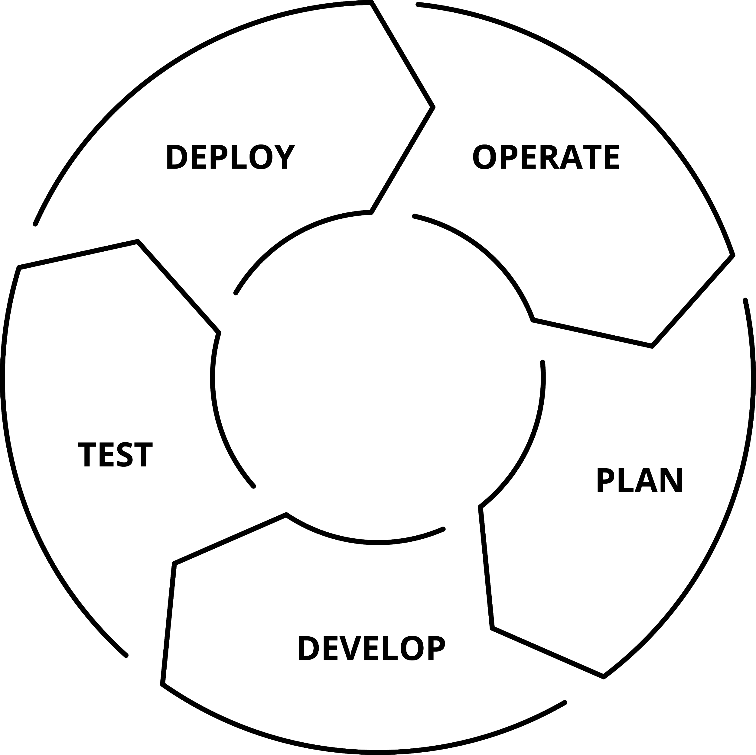
WHY AUTOMATE YOUR NETWORK?
PLAN AND PROTOTYPE VIRTUALLY
Use tasks as reusable building blocks
USE YOUR CURRENT DEVELOPMENT PRACTICES
Agile, DevOps, Waterfall
GO BEYOND THE “PING” TEST
Integrate with formal testing platforms
BE CONFIDENT DURING DEPLOYMENT
Validate changes were successful
ENSURE AN ON-GOING STEADY-STATE

Slide 50
AUTOMATION FOR EVERYONE: NETWORK ENGINEERS
---
- hosts: cisco
gather_facts: false
connection: network_cli
tasks:
- name: show command for cisco
cli_command:
command: show ip int br
register: result
- name: display result to terminal window
debug:
var: result.stdout_lines

Slide 51
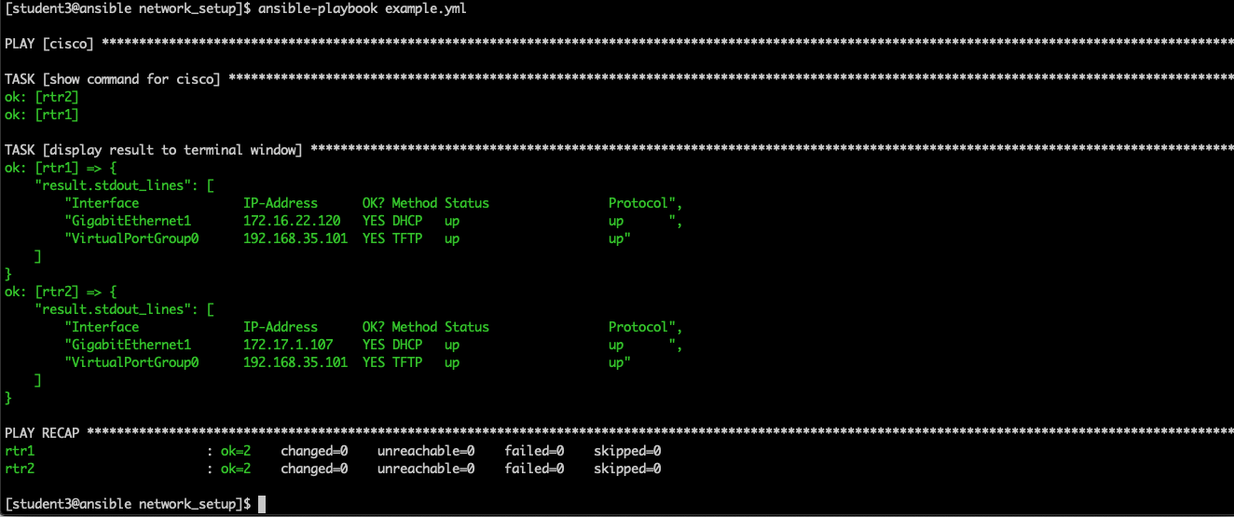
AUTOMATION FOR EVERYONE: PLAYBOOK RESULTS

Slide 52
AUTOMATION FOR EVERYONE: NETWORK ENGINEERS
---
- hosts: juniper
gather_facts: false
connection: network_cli
tasks:
- name: show command for juniper
cli_command:
command: show interfaces terse em1
register: result
- name: display result to terminal window
debug:
var: result.stdout_lines

Slide 53
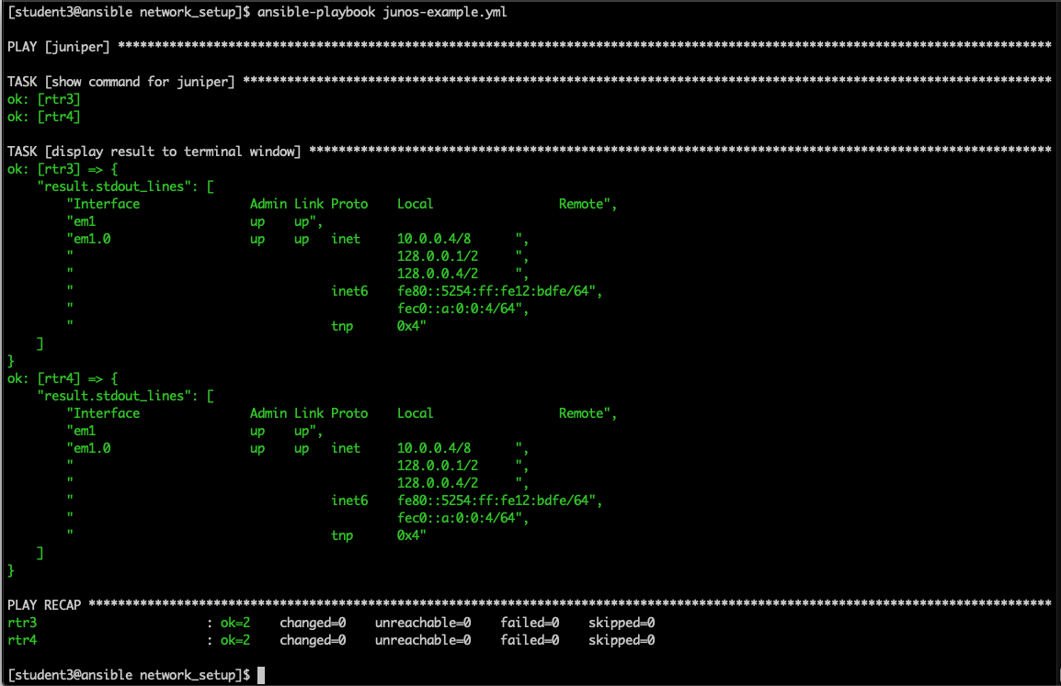
AUTOMATION FOR EVERYONE: PLAYBOOK RESULTS

Slide 54
USE CASE: WINDOWS AUTOMATION

Slide 55
WINDOWS AUTOMATION
90+
Windows Modules
1,300+
Powershell DSC resources
ansible.com/windows
Notes:
Ansible Windows module count can be derived from https://docs.ansible.com/ansible/devel/modules/list_of_windows_modules.html
PowerShell DSC Resources commands (needs to be run on a Windows host)
Unique DSC Resources
Find-DscResource | Measure-Object
Unique DSC Modules
Find-DscResource | Select-Object -Property modulename -Unique | Measure-Object
Builtin DSC Resources (comes pre-installed with Windows and at this time is around 20 resources)
https://docs.microsoft.com/en-us/powershell/dsc/resources/resources
A DSC Resource is comparable to an Ansible module where it manages an individual resource whereas a DSC Module is a collection of similar resources, e.g. a DSC Module that can be downloaded would be xHyper-V https://github.com/PowerShell/xHyper-V. It contains numerous resources like MSFT_xVMHyperV, MSFT_xVMHost and so on https://github.com/PowerShell/xHyper-V/tree/dev/DSCResources. The code quality of each DSC resource varies as they are public and potentially managed outside of Microsoft. This is similar to the wide range of quality that can be found on Ansible Galaxy.

Slide 56
AUTOMATION FOR EVERYONE: WINDOWS ADMINS
---
- name: windows playbook
hosts: new_servers
tasks:
- name: ensure local admin account exists
win_user:
name: localadmin
password: '{{ local_admin_password }}'
groups: Administrators

Slide 57
AUTOMATION FOR EVERYONE: WINDOWS ADMINS
---
- name: windows playbook
hosts: windows_machines
tasks:
- name: ensure common tools are installed
win_chocolatey:
name: '{{ item }}'
loop: ['sysinternals', 'googlechrome']

Slide 58
AUTOMATION FOR EVERYONE: WINDOWS ADMINS
---
- name: update and reboot
hosts: windows_servers
tasks:
- name: ensure common OS updates are current
win_updates:
register: update_result
- name: reboot and wait for host if updates change require it
win_reboot:
when: update_result.reboot_required

Slide 59
AUTOMATION FOR EVERYONE: WINDOWS ADMINS
---
- name: update domain and reboot
hosts: windows_servers
tasks:
- name: ensure domain membership
win_domain_membership:
dns_domain_name: contoso.corp
domain_admin_user: '{{ domain_admin_username }}'
domain_admin_password: '{{ domain_admin_password }}'
state: domain
register: domain_result
- name: reboot and wait for host if domain change require it
win_reboot:
when: domain_result.reboot_required

Slide 60
USE CASE: CLOUD AUTOMATION

Slide 61
CLOUD AUTOMATION
800+
Cloud Modules
30+
Cloud Platforms
ansible.com/cloud
Notes:
Microsoft Azure, Google Compute Engine (GCE), Amazon Web Services, Red Hat Openstack, and more
https://docs.ansible.com/ansible/devel/modules/list_of_cloud_modules.html

Slide 62
PLAYBOOK EXAMPLE: AWS
---
- name: aws playbook
hosts: localhost
connection: local
tasks:
- name: create AWS VPC ansible-vpc
ec2_vpc_net:
name: "ansible-vpc"
cidr_block: "192.168.0.0/24"
tags:
demo: the demo vpc
register: create_vpc

Slide 63
PLAYBOOK EXAMPLE: AZURE
---
- name: azure playbook
hosts: localhost
connection: local
tasks:
- name: create virtual network
azure_rm_virtualnetwork:
resource_group: myResourceGroup
name: myVnet
address_prefixes: "10.0.0.0/16"

Slide 64
PLAYBOOK EXAMPLE: RED HAT OPENSTACK
---
- name: openstack playbook
hosts: localhost
connection: local
tasks:
- name: launch an instance
os_server:
name: vm1
cloud: mordred
region_name: ams01
image: Red Hat Enterprise Linux 7.4
flavor_ram: 4096

Slide 65
USE CASE: SECURITY AUTOMATION

Slide 66
WHAT IS IT?
Ansible Security Automation is a supported set of Ansible modules, roles and playbooks designed to unify the security response to cyberattacks in a new way - by orchestrating the activity of multiple classes of security solutions that wouldn’t normally integrate with each other.

Slide 67
WHAT DOES IT DO?
Through Ansible Security Automation, IT organizations can address multiple popular use cases:
For detection and triage of suspicious activities, for example, Ansible can automatically enable logging or increase the log verbosity across enterprise firewalls and IDS to enrich the alerts received by a SIEM for an easier triage.
For threat hunting, for example, Ansible can automatically create new IDS rules to investigate the origin of a firewall rule violation, and whitelist those IP addresses recognized as non threats.
For incident response, for example, Ansible can automatically validate a threat by verifying an IDS rule, trigger a remediation from the SIEM solution, and create new enterprise firewall rules to blacklist the source of an attack.
At launch, Red Hat's Ansible security automation platform provides support for:
Check Point – Next Generation Firewall (NGFW);
Splunk – Splunk Security Enterprise (SE);
Snort

Slide 68
WHO IS IT FOR?
Ansible Security Automation extends the Ansible agentless, modular and easy to use enterprise automation platform to support the following industry constituencies:
End-user organizations’ security teams in charge of Security Operations Centres (SOCs)
Managed security service providers (MSSPs) responsible for the governance of thousands of enterprise security solutions across their whole customer base
Security ISVs offering security orchestration and automation (SOAR) solutions currently using custom-made automation frameworks

Slide 69
AUTOMATION FOR EVERYONE: SECURITY OPERATIONS
---
- name: checkpoint playbook
hosts: checkpoint
connection: httpapi
tasks:
- name: create access rule
checkpoint_access_rule:
layer: Network
name: "Drop attacker"
position: top
source: attacker
destination: Any
action: Drop

Slide 70
AUTOMATION FOR EVERYONE: SECURITY OPERATIONS
---
- name: checkpoint playbook
hosts: checkpoint
connection: httpapi
tasks:
- name: delete access rule
checkpoint_access_rule:
layer: Network
name: "Drop attacker"
state: absent

Slide 71
NEXT STEPS
GET STARTED
JOIN THE COMMUNITY
ansible.com/community
ansible.com/get-started ansible.com/tower-trial
WORKSHOPS & TRAINING
SHARE YOUR STORY
Follow us @Ansible
Friend us on Facebook
ansible.com/workshops
Red Hat Training

